Slide 1




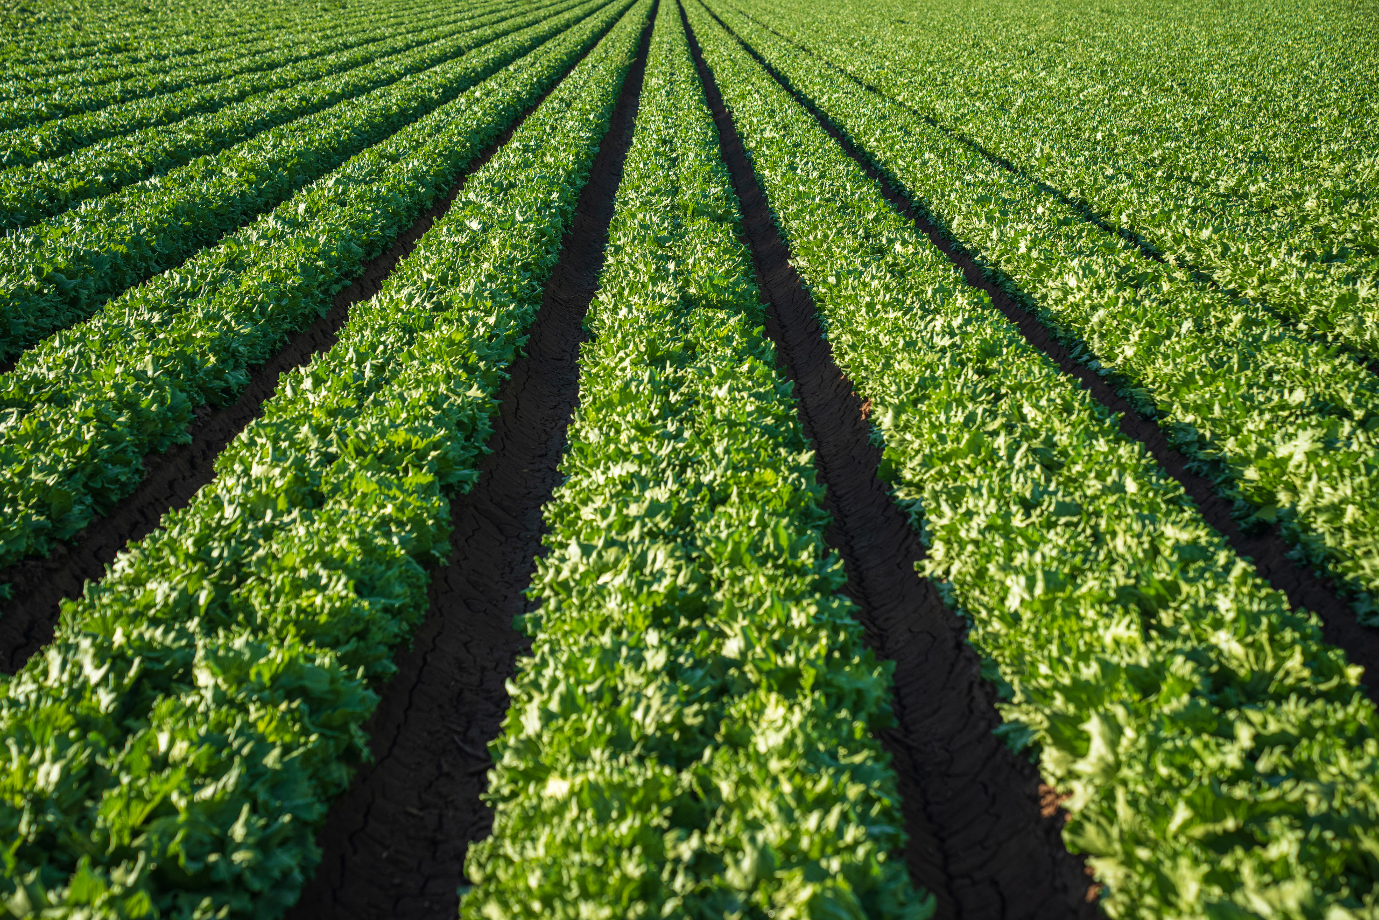



ALL ABOUT
Climanage
PRESENTATION

Slide 2
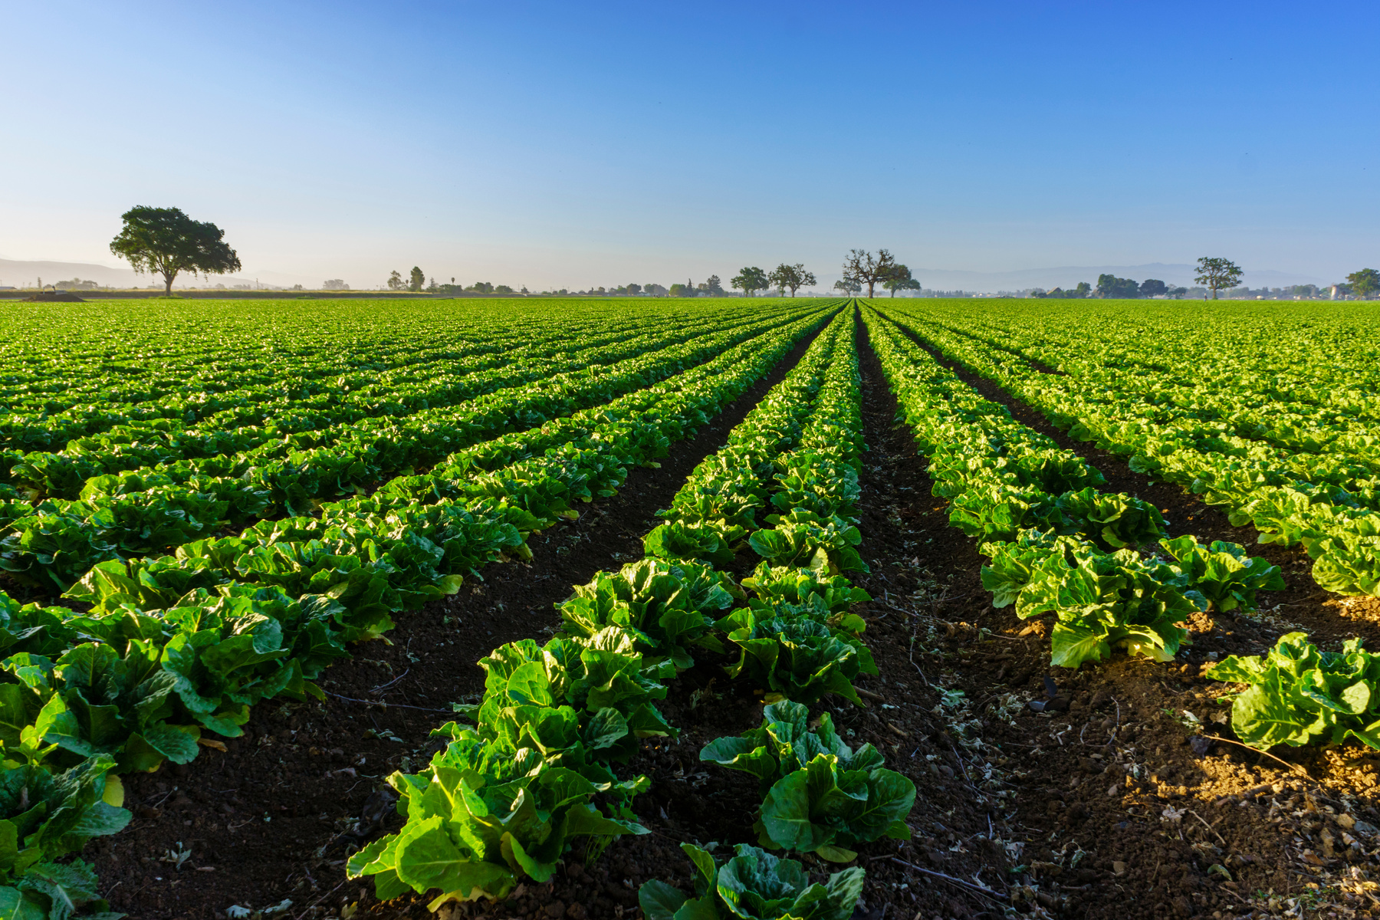
What is a Climanage ?
Climanage specializes in drone technology and the PUSA Bio-Decomposer for sustainable agriculture. We provide innovative solutions to enhance crop management, reduce environmental impact, and promote eco-friendly farming practices. Through advanced drone services and the application of the PUSA Bio-Decomposer, we help clients maximize yields, improve soil health, and contribute to a greener and more sustainable agricultural future.

Slide 3
CLIMANAGE PROVIDES PERSONALIZED DRONE SPECIALIST SERVICES DIRECTLY TO FARMERS.
WE OFFER CONVENIENT DRONE RENTAL OPTIONS, ENSURING ACCESS TO CUTTING-EDGE TECHNOLOGY.
How we Work ?
OUR ON-SITE EXPERTS COLLABORATE CLOSELY WITH FARMERS TO TAILOR DRONE SOLUTIONS, ENHANCING CROP MANAGEMENT AND PROMOTING SUSTAINABLE AGRICULTURE.

Slide 4

Difference b/w Climanage and Manual Labor
At climanage, the utilization of drones for the application of Pusa bio decomposer offers enhanced efficiency by substituting manual labor, resulting in time and cost savings.
Additionally, the organic manure produced through the application of Pusa decomposer can be supplied to Climanage, enabling farmers to generate an extra source of income.

Slide 5
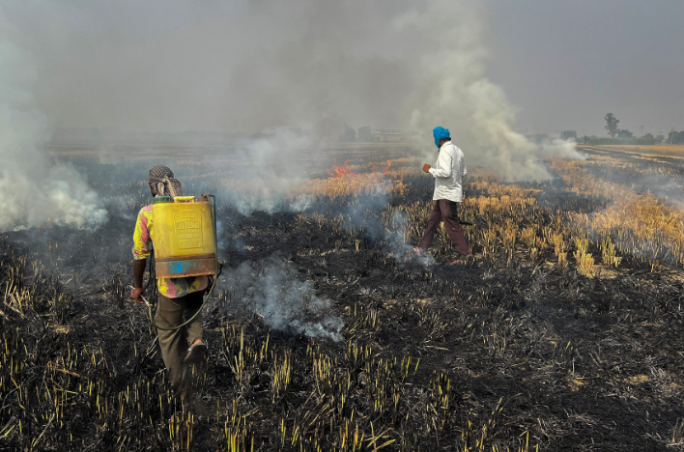
Problems with
Stubble Burning
Air Pollution
Health Impacts
Environmental Damage
Loss of Biodiversity
Economic Costs
Visibility and Safety
Legal Consequences
Social Conflicts
Resource Waste
Alternative Solutions

Slide 6
Solutions
By using PUSA Bio-Decomposer
Eliminating Stubble Burning: It accelerates crop residue decomposition, reducing the need for harmful stubble burning.
Nutrient Enhancement: PUSA Bio-Decomposer enriches the soil with organic matter and nutrients, improving soil health and fertility.
Environmental Benefits: It reduces air pollution, greenhouse gas emissions, and legal compliance issues associated with stubble burning, promoting sustainable agriculture and healthier communities.

Slide 7
Market Analysis
By using Climanage
"By employing our methods, we aim to increase the usage of Pusa fertilizer in Delhi from 1935 to 3000, according to our estimates."

Slide 8
Conclusion
In conclusion, the integration of drones for the efficient application of Pusa bio decomposer not only saves valuable time and reduces costs but also opens up opportunities for farmers to generate additional income by supplying the resultant organic manure to Climanage. This innovative approach not only aids in climate management but also contributes to sustainable agriculture practices, benefiting both the environment and farming communities. It underscores the potential for technology-driven solutions to address the challenges posed by climate change while fostering economic growth in agriculture.

Slide 9
Thank You

